Slide 1
Discrete Structures
CS-1005
GCR: e2d2awt
Lecture -2
by
Dr. Fehmida Usmani

Slide 2
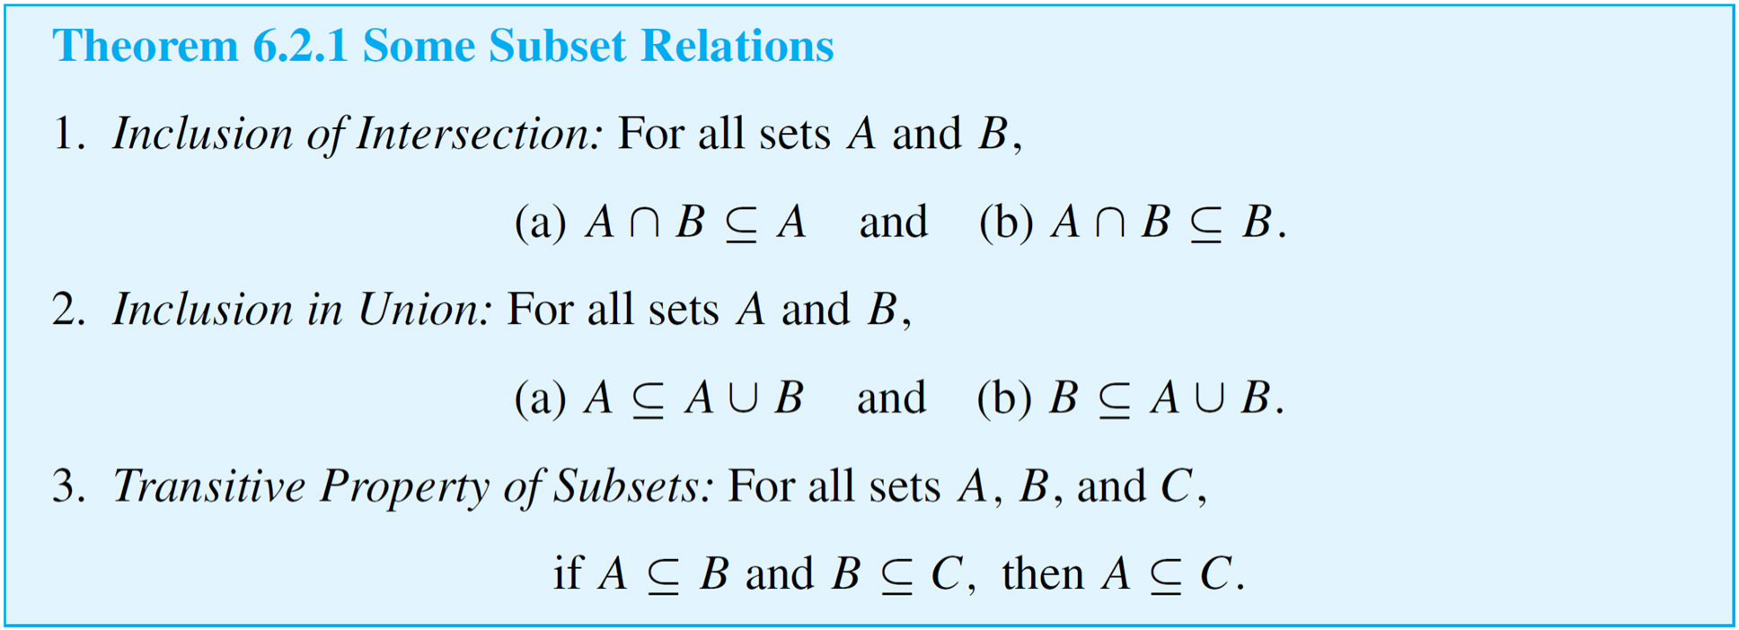
Properties of Sets
We begin by listing some set properties that involve subset relations.

Slide 3
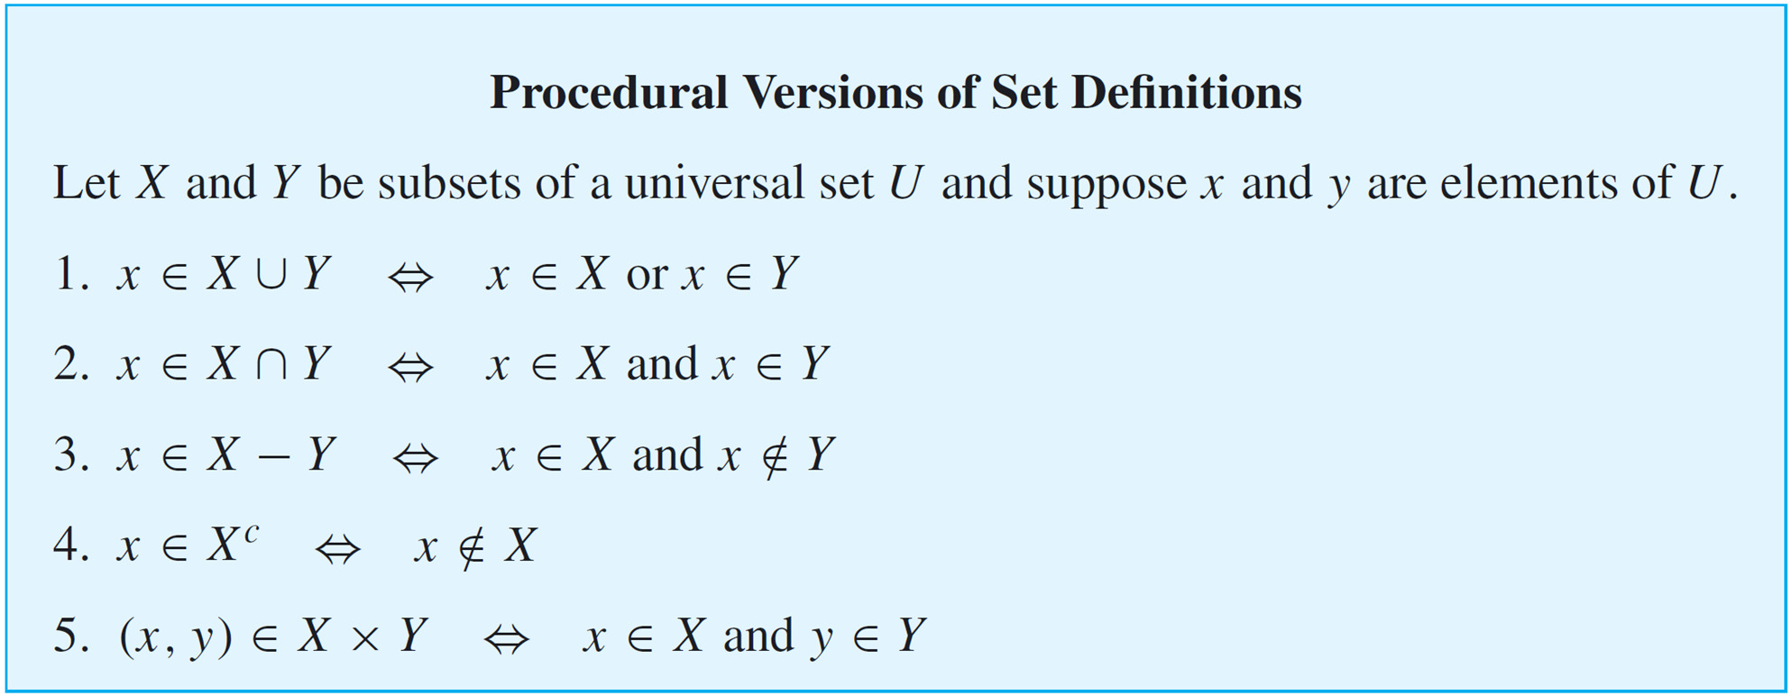
Properties of Sets
Procedural versions of the definitions of the other set operations are derived similarly and are summarized below.

Slide 4
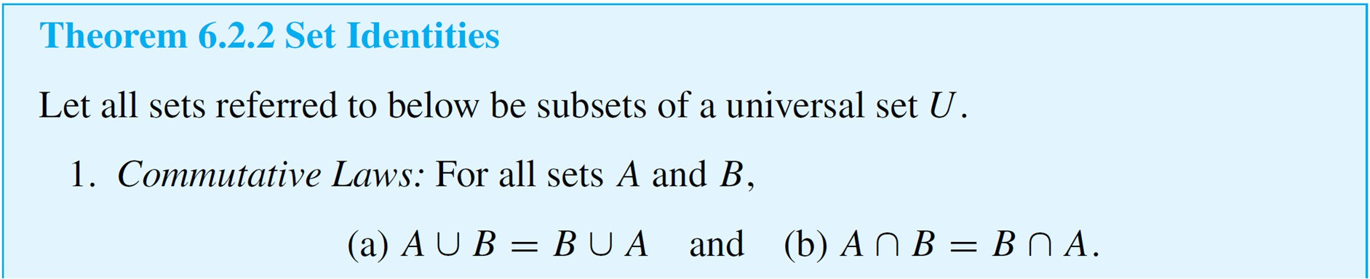
Set Identities
An identity is an equation that is universally true for all elements in some set. For example, the equation
a + b = b + a is an identity for real numbers because it is true for all real numbers a and b.
The collection of set properties in the next theorem consists entirely of set identities. That is, they are equations that are true for all sets in some universal set.

Slide 5
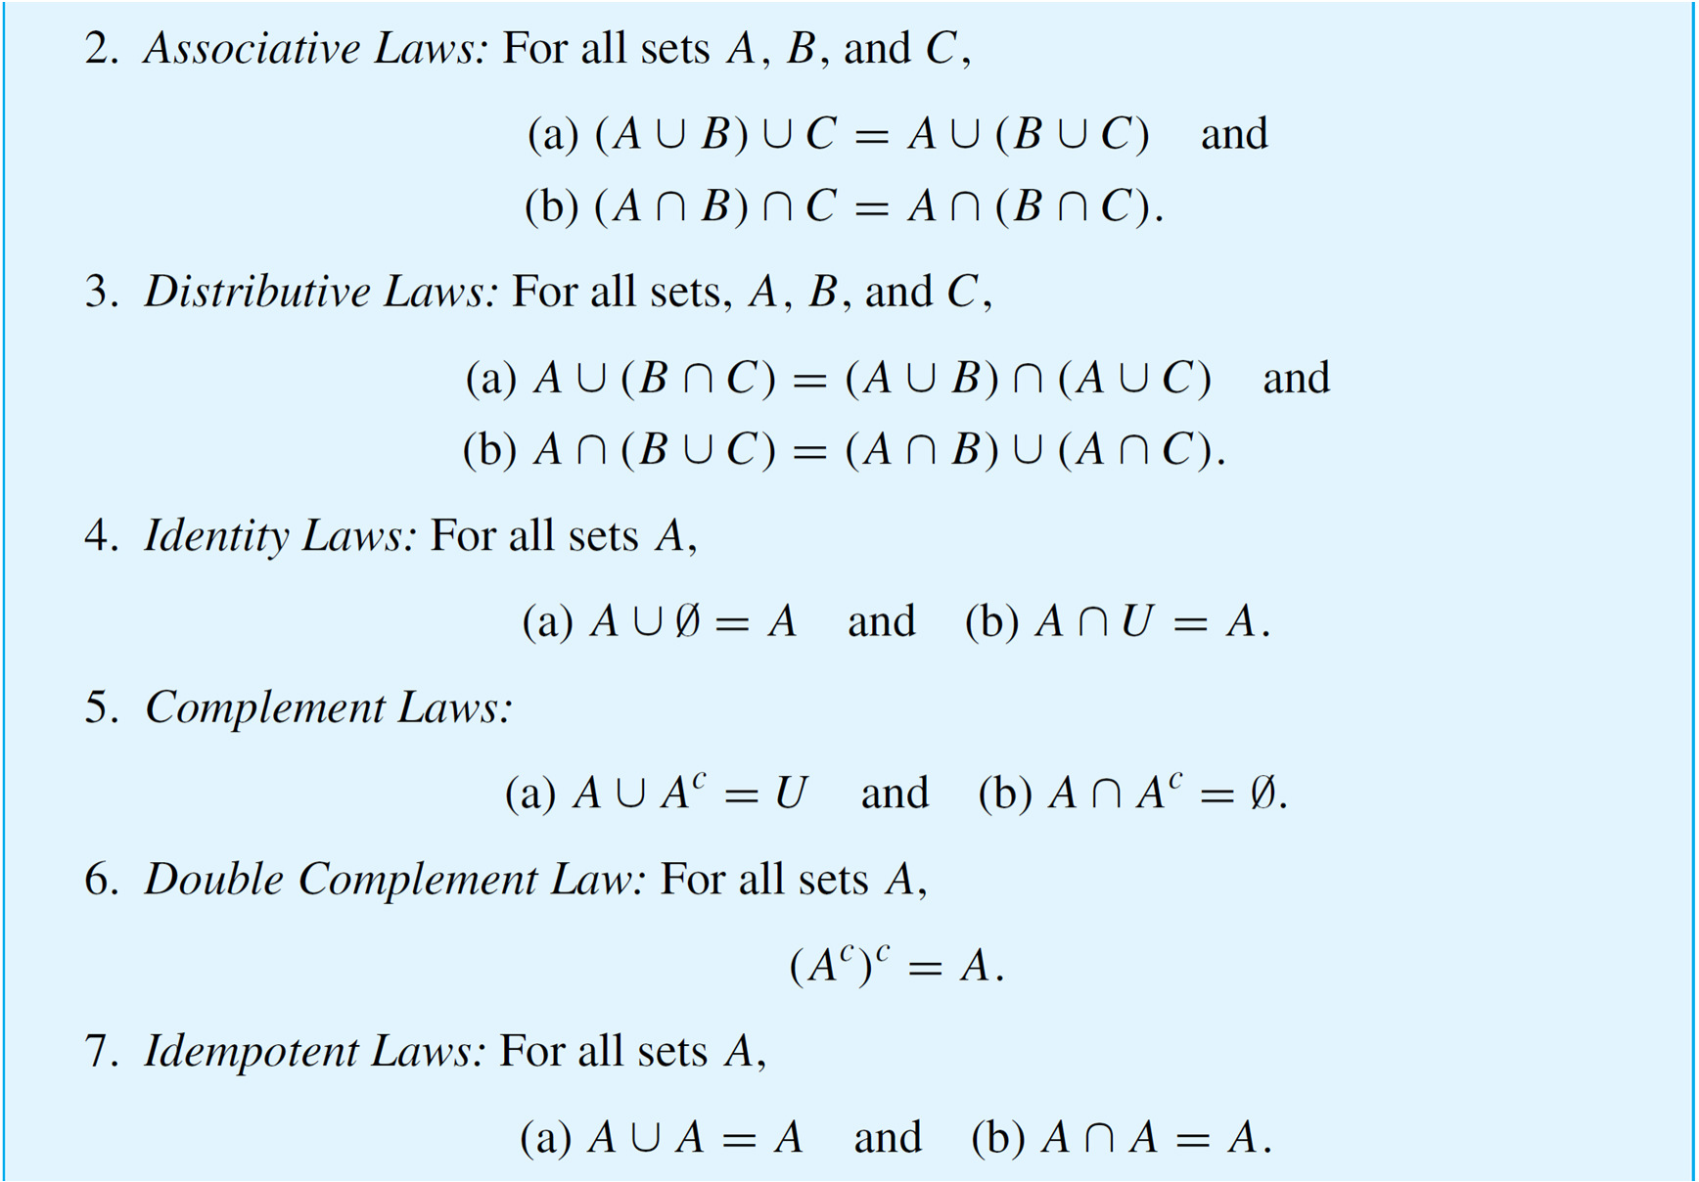
Set Identities

Slide 6
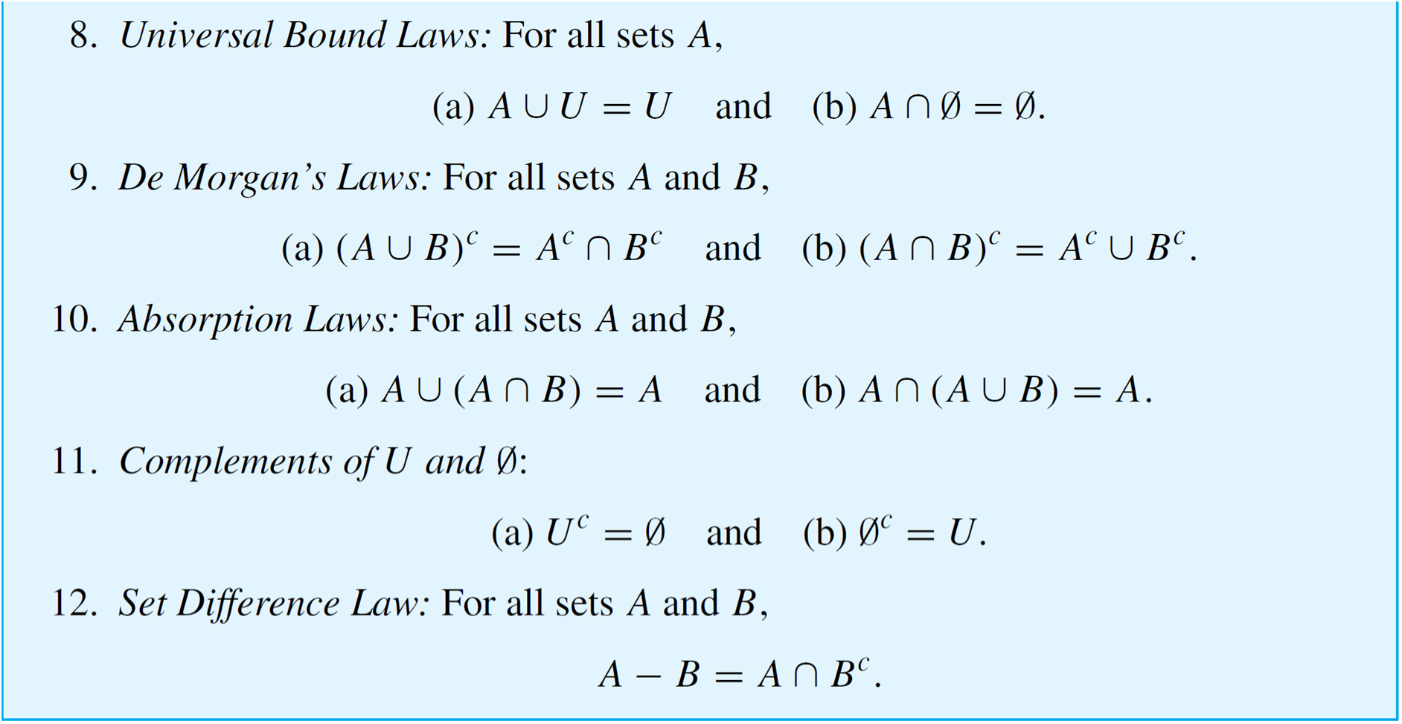
Set Identities

Slide 7
Proving Set Identities
Four methods:
Use the basic set identities
Use membership tables
Prove each set is a subset of each other
Use set builder notation and logical equivalences

Slide 8
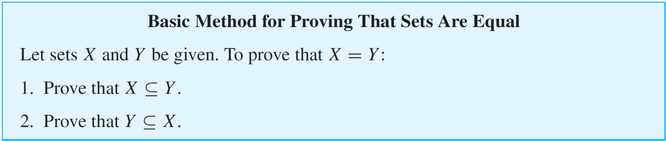
Proving Set Identities
As we have known,
Two sets are equal ⇔ each is a subset of the other.
The method derived from this fact is the most basic way to prove equality of sets.

Slide 9
Proving Set Identities
Example 1 : Prove that A ∩ (B ∪ C)=(A ∩ B) ∪ (A ∩ C)
Solution: Show A ∩(B∪C)⊆(A∩B)∪(A∩C)
Let x ∈ A ∩(B∪C)
This means x ∈ A and x ∈ B ∪ C
Since x ∈ B ∪ C, x is either in B or in C
If x ∈ B, then x ∈ A ∩ B
If x ∈ C, then x ∈ A ∩ C
In either case, x ∈ (A ∩ B)∪(A ∩ C)

Slide 10
Proving Set Identities
Example 1 : Prove that A ∩ (B ∪ C)=(A ∩ B) ∪ (A ∩ C)
Solution: Show (A∩B)∪(A∩C)⊆A∩(B∪C)
Let x ∈ (A ∩ B) ∪ (A ∩ C)
This means x is either in A ∩ B or in A ∩ C
If x ∈ A ∩ B, then x ∈ A and x ∈ B
If x ∈ A ∩ C, then x ∈ A and x ∈ C
In either case, x ∈ A and x ∈ B ∪ C
Therefore, x ∈ A ∩ (B ∪ C)

Slide 11
Proving Set Identities
Example 2: Prove that A ∪ (B ∩ C)=(A ∪ B) ∩ (A ∪ C)
Solution: Show A ∪ (B ∩ C)⊆(A ∪ B) ∩ (A ∪ C)
Let x ∈ A ∪ (B ∩ C)
This means x ∈ A or x ∈ B ∩ C
If x ∈ A, then x ∈ A∪B and x ∈ A∪C
If x ∈ B ∩ C, then x ∈ B and x ∈ C , so x ∈ A∪B and x ∈ A∪C
In either case, x ∈ (A ∪ B) ∩ (A∪C)

Slide 12
Proving Set Identities
Example 2: Prove that A ∪ (B ∩ C)=(A ∪ B) ∩ (A ∪ C)
Solution: ( A ∪ B) ∩ (A∪C)⊆A∪(B∩C)(A ∪ B) ∩ (A ∪ C)
Let x ∈ (A∪B) ∩ (A∪C)
This means x ∈ A∪B and x ∈ A ∪ C
If x∈A, then x ∈ A∪(B∩C)
If x ∉A, then x ∈ B and x ∈ C, so x ∈ B ∩ C and x ∈ A∪(B∩C)
Therefore, (A∪B)∩(A∪C)⊆A∪(B∩C)(A ∪ B) ∩ (A ∪ C)

Slide 13
Disproving an Alleged Set Property
The phrase "Disproving an Alleged Set Property" means showing that a certain statement or property about sets is incorrect. This typically involves providing a counterexample—a specific example where the property does not hold true, which demonstrates that the property is not valid for all cases.

Slide 14
Disproving an Alleged Set Property
Finding a Counterexample for a Set Identity
Is the following set property true?
For all sets A, B, and C,
Solution:
Observe that the property is true if, and only if,
the given equality holds for all sets A, B, and C.
So it is false if, and only if,
there are sets A, B, and C for which the equality does
not hold.

Slide 15
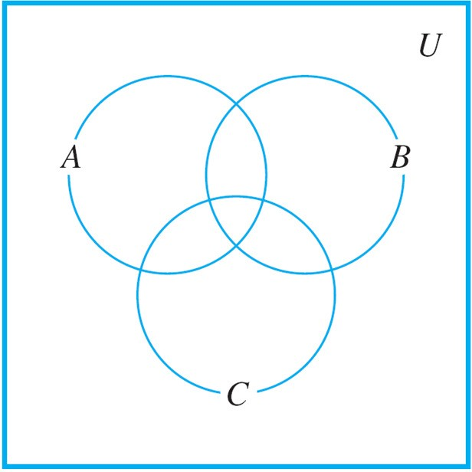
Disproving an Alleged Set Property
One way to solve this problem is to picture sets A, B, and C
by drawing a Venn diagram such as that shown in Figure

Slide 16
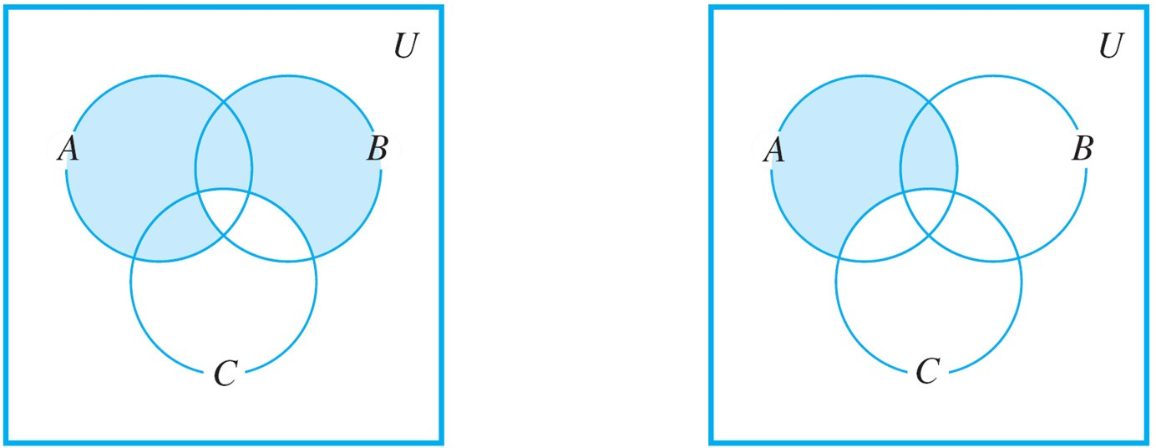
Disproving an Alleged Set Property
Find and shade the region corresponding to (A – B) ∪ (B – C).
Then shade the region corresponding to A – C.

Slide 17
Disproving an Alleged Set Property
Comparing the shaded regions seems to indicate that the property is false.
For instance, if there is an element in B that is not in either A or C then this element would be in (A – B) ∪ (B – C) (because of being in B and not C) but it would not be in
A – C since A – C contains nothing outside A.
Similarly, an element that is in both A and C but not B would be in (A – B) ∪ (B – C) (because of being in A and not B), but it would not be in A – C (because of being in both A and C).

Slide 18
Disproving an Alleged Set Property
Then
Hence

Slide 19
Problem Solving Strategy
How can you discover whether a given universal statement about sets is true or false? There are two basic approaches: the optimistic and the pessimistic.
In the optimistic approach, you simply plunge in and start trying to prove the statement, asking yourself, “What do I need to show?” and “How do I show it?”
In the pessimistic approach, you start by searching your mind for a set of conditions that must be fulfilled to construct a counterexample.
With either approach you may have clear sailing and be immediately successful or you may run into difficulty.

Slide 20
Algebraic Proofs of Set Identities
Once a certain number of identities and other properties have been established, new properties can be derived from them algebraically.
To use known properties to derive new ones, you need to use the fact that such properties are universal statements. Like the laws of algebra for real numbers, they apply to a wide variety of different situations.

Slide 21
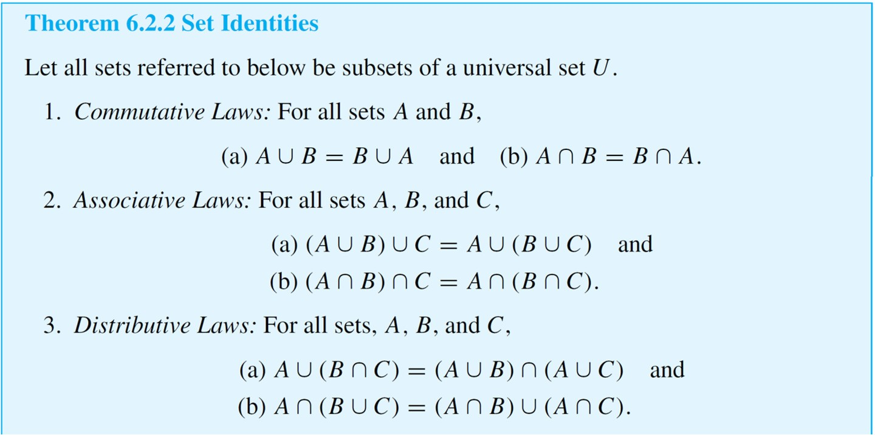
Algebraic Proofs of Set Identities

Slide 22
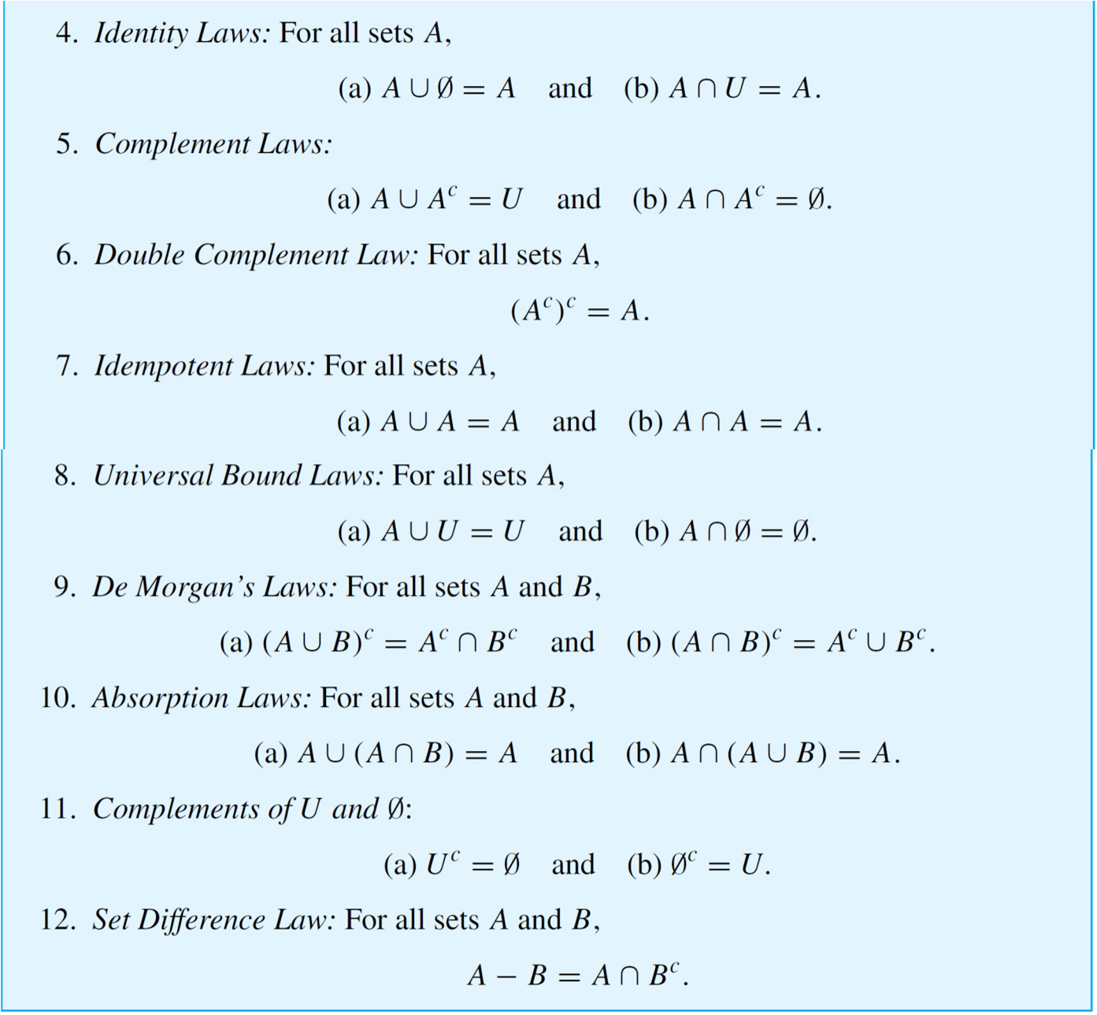
Algebraic Proofs of Set Identities

Slide 23
Algebraic Proofs of Set Identities
Example: Construct an algebraic proof that for all sets A and B,
Cite a property from Theorem 6.2.2 for every step of the proof.
Solution:
Suppose A and B are any sets. Then

Slide 24
Algebraic Proofs of Set Identities

